Slide 1
Energy Demand - socioeconomic basis
Society Energy Environment systems modelling
Mark Barrett
Mark.Barrett@ucl.ac.uk
UCL Energy Institute

Slide 2
SEE Energy Demand - socioeconomic : Contents
Demography
Dwellings
Activities
Consumption
  Technologies
  Expenditure
Economy

Slide 3
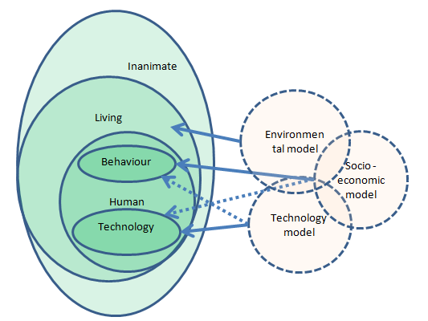
The society, energy environment system and models

Slide 4
Homo sapiens
Energy and material demands
  tissue formation and maintenance
  keeping warm, keeping cool
  movement
  information processing
Energy from oxidising carbon in food, renewable biomass
Refined control systems to minimise energy and water consumption
Comfort is when energy and water consumption is minimised
Most exosomatic services (buildings, transport) designed to minimise endosomatic energy consumption, to achieve comfort – this is a basic driver of energy demand
e.g. 10% UK energy & emissions to keep warm air next to skin

Slide 5
History of people and energy
-5000 to 0 AD. Agriculture, animals
0 to 1500 AD. Technological renewables
1800 to 2010. First part of fossil era

Slide 6
History and future of people and energy?
1950 to 2100. Transition fossil to renewable
1800 to 2300. . Transition fossil to renewable
0 to 2500. Renewable => fossil => renewable. Steady state humanity?

Slide 7
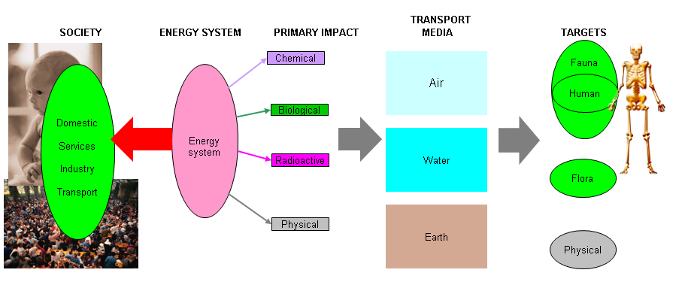
The society, energy, environment system
People in society have energy service demands that are met by energy systems which cause primary inputs to the environment. These inputs are modified and transported via media to impact on biota.

Slide 8
The energy service chain
SERVICE CHAIN
Energy required to make and operate service delivery system.
Services and supplies have spatiotemporal distributions (some weather dependent)
Storage improves security
A given energy system has a configuration of these principal components:
Demands (D): heating, lighting, transport, etc.
Converters (C): convert energy in one form and place to another
Artificial stores (A): heat, work
Natural stores (N): heat, work
And it operates in an environment
Environment (V)

Slide 9
Energy services

Slide 10
Energy services and demand drivers
Demands for energy services are determined by human needs, these include
food
comfort, hygiene, health
culture
Important drivers of demand include:
Population increases
Households increase faster because of smaller households
Wealth, but energy consumption and impacts depend on choices of expenditure on goods and services which are somewhat arbitrary
The drivers are assumed to be the same in all scenarios.
The above drivers are simply accounted for in the model, but others are not, for example:
Population ageing, which will result in increases and decreases of different demands
Changes in employment
Environmental awareness
Economic restructuring
More on consumption at:
http://www.sencouk.co.uk/Consumption/Consumption.htm

Slide 11
Future demand: activity projections
In these scenarios, the activity growth in all sectors is assumed to follow from population, household and wealth drivers. The activity projections are shown in the chart. The outstanding growth is in international aviation, a service the UK mainly exports.

Slide 12
Future demand: general considerations 1
Predicting the activities that drive the demands for energy is fundamentally important, but uncertain, not least because activities are partially subject to policy.
Some demands may stabilise or decrease, for example:
  commuting travel as the population ages and telecommunications develop
  space heating as maximum comfort temperature levels are achieved
Demands may increase because of the extension of current activities:
  heating might extend to conservatories, patios, swimming pools
  air conditioning may become more widespread
  cars might become heavier and more powerful
  as the population enjoys more wealth and a longer retirement, more leisure travel might ensue
Or because new activities are invented, these being difficult to predict:
  new ways of using energy might arise; witness home computers, cinemas, mass air travel in the past; the future we may see space tourism
Basic activity levels are assumed to be the same in all scenarios, although in reality they are scenario dependent. For example, many activities are influenced by scenario dependent fuel prices - the purchase and use of cars, air travel, home heating.

Slide 13
Future demand: general considerations 2
Furthermore, energy consumption in the services sector and industrial sectors are themselves dependent on basic energy service demands. For example:
energy consumption for administering public transport or aviation is dependent on the demands for those services;
the energy consumed in the iron and steel or vehicle manufacturing industry depends on how many cars are made, which is scenario dependent;
the energy consumption of manufacturing industry depends on how much loft insulation there is houses.
The effects of energy demands on economic structure and its energy consumption are not considered here. (This is rarely analysed in energy scenarios because the effects of these structural changes and it is difficult to calculate them may be relatively small; .)

Slide 14
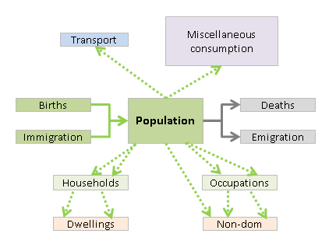
Demography and consumption

Slide 15
Demographic projections
Projections depend on assumptions about birth, death and migration.
These assumptions can change rapidly because of altered policy and other context, e.g. on:
immigration
health
child support
‘culture’
The National Population Projections indicate an uncertainty of 10-15% in the 2050 population with accompanying energy and emissions.
Source for projection: Helen Bray and Shayla Goldring, National Population Projections and the challenges of an ageing population.
www2.lse.ac.uk/socialPolicy/BSPS/ppt/2008_PP_Goldring.ppt
Also see: www.gad.gov.uk

Slide 16
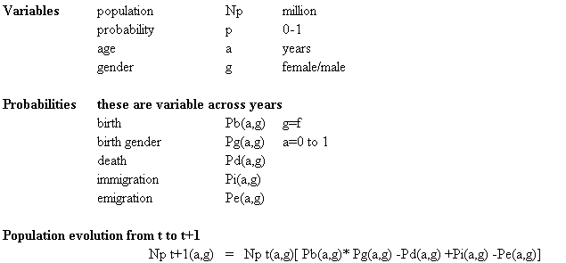
A Demography model

Slide 17
Demography model inputs and outputs (UK)
Age distribution by sex, 2008
Probability of dying in year
Population change: birth, death, migration probabilities
Population change: birth, death, migration changes

Slide 18
Future UK demography: population and age
Population forecasts change rapidly; latest higher growth because of more immigration and higher fertility.
Very probable growth in relative numbers of older people.

Slide 19
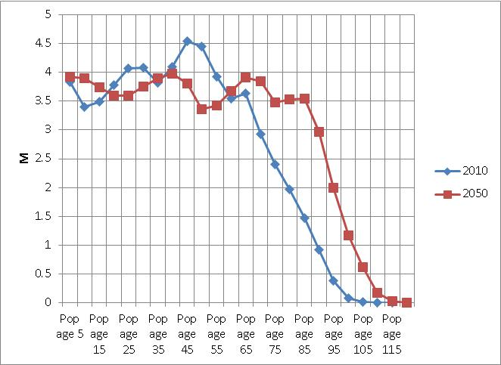
Future UK demography: population and age
Ageing population, at least in the UK…
How will the activities of people of different ages change?
What sort of buildings and transport will we need for these activities?
Age profiles for 2010 and 2050 from model From Government Actuarial Department
(allocation to activity by Barrett)

Slide 20
Household formation
Given a population how will it form households of different compositions?
different numbers of Adults (over and under 60), and Children
wealth
activities
Composition 2007

Slide 21
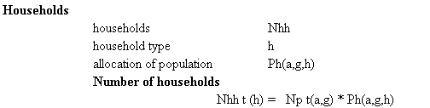
Household formation model
Assume allocation of people to households based on history or some assumed changes in the future

Slide 22
Future UK demography : household model projection
Households with different numbers of Adults (over and under 60), and Children assuming:
Population projection
Unchanged allocation to households
Large increase in single person households
Fraction of people in non-domestic residence increases with ageing (and students etc.)

Slide 23
Households, dwellings: history
Households
Dwellings
?

Slide 24
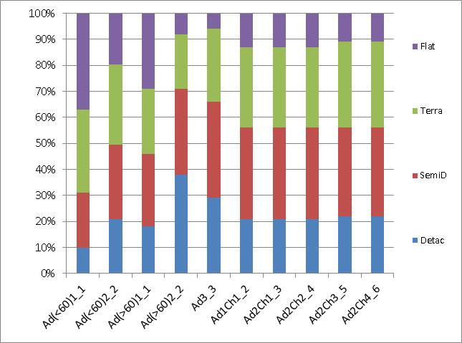
UK demography and dwellings, 2007
What sort of houses do households live in according to size, age, activities, wealth etc.?
Households with different numbers of Adults (over and under 60), and Children in different dwelling forms

Slide 25
Dwelling stock model
How will dwelling stock evolve with households?
Physical
Location
Form – detached, semidetached, terrace, flat, residential
Size – number of bedrooms etc.
Efficiency – insulation etc.
Energy system – boiler, heat pump, etc.
Need some mapping of households on to these variables, e.g. for form.

Slide 26
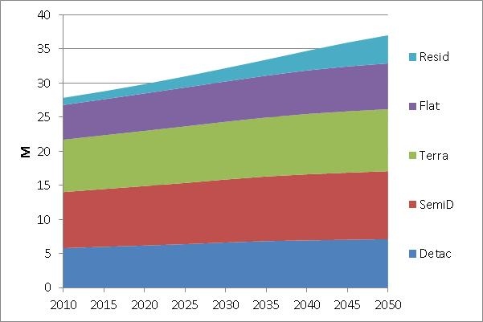
Future UK dwellings: built form
How will the stock be altered and used to accommodate different households?
What social dynamics? - e.g. older people often have capital and retain large family houses after children have left.
Effects of drivers:
increasing wealth
Increasing age
Energy costs
Projection of dwellings from households Assuming unchanged population=>household probabilities

Slide 27
Future UK population, households and household size
More people
smaller households
more dwellings
more energy per person

Slide 28
Future building needs: EU population
Europe and global population stabilising over next 15-60 years
Europe population forecast – peaking around 2015

Slide 29
Future building needs: Europe households
Smaller households
More households

Slide 30
World building needs
Ageing population everywhere
Less developed regions
Population growth about 3 billion (40%) percent to 2050
number of households will grow by about 1.6 billion (80 %) - decreasing household size a factor.
Rapid urbanisation. China +0.4 billion more urban dwellers in 20 years; India, similar trend
Developed regions
nearly static

Slide 31
Personal time use and space
How do people’s activities change in time and space?
This determines :
The requirements for services in buildings – space heat, hot water, cooking, lighting etc.
People’s exposure to pollutants in different spaces
Transport needs
Use of time and space varies with demographic and economic variables. Personal time use varies with:
Minutes, hours, week day, month
Age and occupation
People generally carry out activities in groups in spaces – offices, classrooms, living rooms…

Slide 32
Homo multicellulus – a life in boxes
~98% of time in stationary or mobile boxes
Most services provided there: food, water, air, energy

Slide 33
Person in building : processes

Slide 34
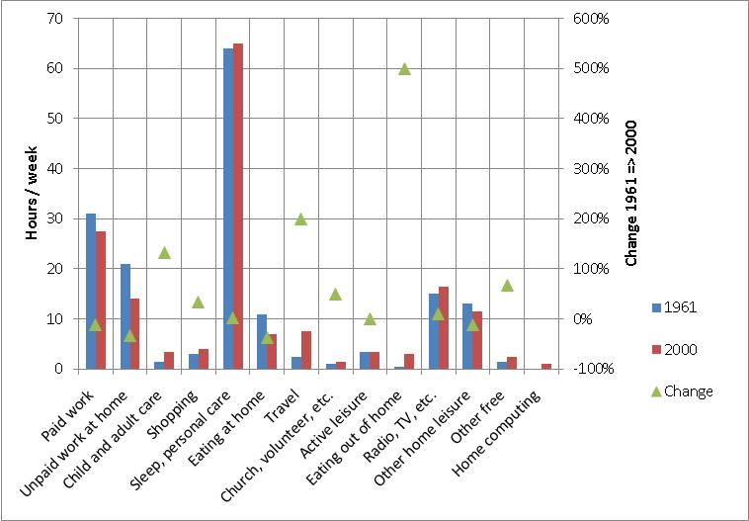
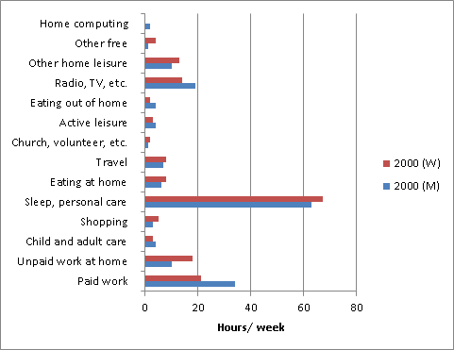
UK Personal time use : annual
Use of time varies:
across the years
and by gender

Slide 35
UK Personal time use : by age

Slide 36
UK Personal time use : by space and activity
By activity
Insulate/heat beds and sofas?
By space
Nearly as much time in vehicles as non-domestic buildings.
Vehicle space heat load larger than non-domestic? Insulate cars?

Slide 37
Travel patterns
The temporal pattern of travel affects transport, planning, congestion, the feasibility of electric vehicles.
Distance and time of day – UK passenger road trips National Travel Survey: 2005/6

Slide 38
Consumption: choice and use of technologies

Slide 39
Energy and emission: manufacturing vs use
Life Cycle Energy and Emissions are incurred in manufacturing (embodied) and using technologies.
In general, the more efficient a technology (car, house) the greater the fraction of embodied energy.

Slide 40
Carbon emission by energy service
Energy and carbon incurred:
Pers(P) Personal private consumption of at home and travelling
Pers(W) Personal at work
Prod’n In production of goods and service

Slide 41
Comfort temperature, clothing and activity
Appropriate clothing reduces energy demand and emissions. A slight improvement in clothing could reduce building temperatures. A degree reduction in average building temperature could reduce space heating needs by about 10%.

Slide 42
Technologies for buildings: electric appliances
Electric appliances a major electricity demand and cause of CO2 and other emissions. Each type of appliance can be improved. Each kWh saved reduces generation emissions in most countries.

Slide 43
Expenditure

Slide 44
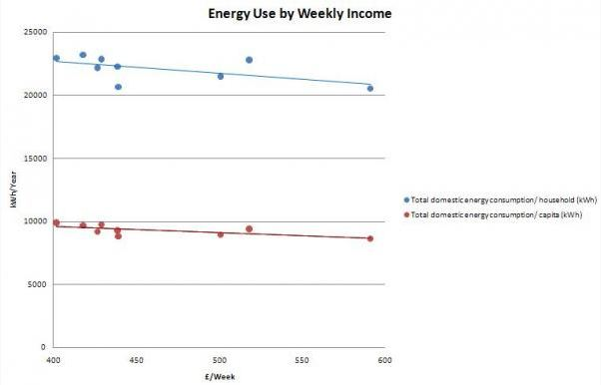
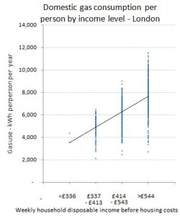
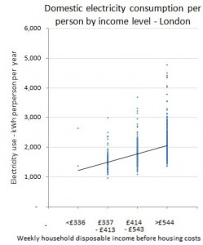
UK income and energy use
Effect of income on:
Size of house?
Amount and type of travel?
Efficiency of house or car?
Fuel type of house or car?

Slide 45
Consumption: carbon and energy intensity

Slide 46
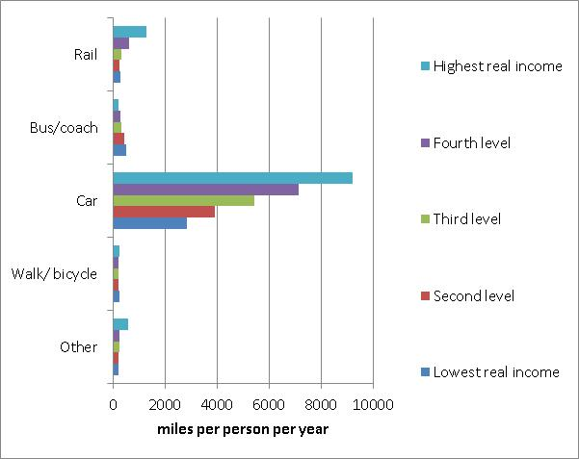
UK income and travel

Slide 47
Lifestyle choice and carbon

Slide 48
Global carbon and population

Slide 49
Ethics: equal CO2 emission per person?
Humans have equal rights to emissions, therefore convergence of emission per person in the EU and elsewhere? What about different resources and climate of countries? Note that for global equity, EU per capita emissions will have to fall by over 95% to reach 60% reduction globally.

Slide 50
The importance of fast measures - avoid tipping points
Chart shows UK national CO2 as a proxy for fossil fuel consumption
Demand measures reduce all upstream energy.
Some cause rapid reduction with large effect on time integrated:
Energy => therefore enhance security
Carbon and other GHG emission => less warming integrated over years,
Air pollution emission and deposition
Chart illustrates integrated global warming reduction 2010-2030

Slide 51
References: Barrett work
General:
http://www.bartlett.ucl.ac.uk/markbarrett/Index.html
UK Energy scenario: presentation http://www.bartlett.ucl.ac.uk/markbarrett/Energy/UKEnergy/UKEneScenarioAnim140206.zip
Consumption: Report on consumption, energy and carbon dioxide including behavioural measures
http://www.bartlett.ucl.ac.uk/markbarrett/Consumption/EneCarbCons05.zip
Renewable electricity system: Feasibility of a high renewable electricity system
http://www.cbes.ucl.ac.uk/projects/energyreview/Bartlett%20Response%20to%20Energy%20Review%20-%20electricity.pdf
http://www.bartlett.ucl.ac.uk/markbarrett/Energy/UKEnergy/UKElectricityGreenLight_100506.ppt
Aviation: http://www.bartlett.ucl.ac.uk/markbarrett/Transport/Air/Aviation.htm
Technical scenarios http://www.bartlett.ucl.ac.uk/markbarrett/Transport/Air/Aviation94.zip
Effects of taxes: http://www.bartlett.ucl.ac.uk/markbarrett/Transport/Air/AvCharge.zip
Transport:
Summary presentation of some Auto-Oil work on transport and air quality, including some non-technical measures
http://www.bartlett.ucl.ac.uk/markbarrett/Transport/Land/AutoOil/JCAPWork.ppt
Large Point Sources: emissions and health effects
http://www.acidrain.org/pages/publications/reports.asp
http://www.bartlett.ucl.ac.uk/markbarrett/Environment/LPS/LPS.htm
Dynamic Physical nergy Model
www.bartlett.ucl.ac.uk/web/ben/ede/BENVGEED/ERG 044.pdf
www.bartlett.ucl.ac.uk/web/ben/ede/BENVGEED/ERG045_complete.pdf

